Slide 1
BHAGWAN MAHAVIR COLLEGE OF MANAGEMENT
Student Details:
Program & Semester | Enrollment Number | Name
MCA SEM-4 | 2205030201016 | Devani Shani R.
MCA SEM-4 | 2205030201035 | Kaklotar Jaydeep R.
MCA SEM-4 | 2205030201047 | Patel Akshitkumar A.

Slide 2
Project Title: DAS ERP System
Objective of the Project: ERP System to Manage Purchase, Manufacturing, Inventory, Sales, Accounting, and Dashboard.
Project Category: Web Application
Front End: Odoo 15.0, Python
Back End: PostgreSQL

Slide 3
System Analysis
● Existing System:
Letstranzact
Nestorbird
Accountserp

Slide 4
● Need for the New System: ○ Mostly Existing Systems are Paid , and not Affordable for Small Businesses. ● The objective of the New System: ○ be affordable for Small Businesses and help them TO grow their business. ● Problem Definition:
○ Users face difficulties in data backups on the application. ○ absence of a dedicated Web Application for Multi Branch and Small Business product management Systems.

Slide 5
Advantages and Limitations of the Proposed System
○ Advantages:
Multi-User
Low cost
Easy to use
Multi-Company(Branching)
Auto Backup
○ Limitations:
Sometime not working for windows

Slide 6
● Project Profile:
Platform : Odoo 15.0
Developer: Devani Shani
Resources & Testing : Kaklotar Jaydeep & Patel Akshitkumar
● Targeted Users:
Small Business
Big business
Multi-branch business
Manufacturer

Slide 7
Coding Standards
● README.md
Write a comprehensive README file that explains the purpose of the project, how to set it up locally, how to run tests, and any other relevant information.
Include badges for build status, code coverage, and other pertinent metrics.
Provide clear instructions on how to contribute to the project and the contribution guidelines.
● CodeComments
Use meaningful variable, function, and component names to make the code self-explanatory.
Add comments to complex sections of code, algorithms, or where the code might not be immediately obvious to others.
Follow a consistent commenting style throughout the project.

Slide 8

Use Case Diagram
Customer
Sale Person
Order
Receive Order
Receive Payment
Payment
Confirm order
Manage product
Login

Slide 9
Use Case Diagram
Sale Manager
Sale Person
Login
Manage Sale
Create Contact
Sale
Dashboard

Slide 10
Use Case Diagram
Purchase Manager
Manage
Purchase
Login
Create Vendor
Purchase
Dashboard

Slide 11
Use Case Diagram
Manufacturing Manager
Manage
Inventory
Login
Manage
Manufacturing
Manufacturing
Dashboard

Slide 12
Use Case Diagram
Account Manager
Manage
Expence
Login
All Account Report
Make Sale Report
Make purchase Report

Slide 13
Use Case Diagram
Admin Manager
Manage
Branch
Login
Manage All Managers

Slide 14
Class Diagram
SECURITY
PRODUCTION
LOGIN
MACHINES
OPERATOR
User_id : Type varchar
Dep_id : Type varchar
Password : Typevarchar
Privilege
M_id: Type varchar
Emp_id: Type varchar
Start_Time:Type varchar
Stop_Time: Type varchar
Unit_data: Type number
Task: Type varchar
Machine: Type char
Task: Type char
Division: Type char
Emp_id Type varchar
get_UserID( )
get_DepID0
get_password
display_machine Alloted()
display_taskAssigned()
display_division()
display_EmpID()
display_MIDO ()
diplay_Empid()
get_startTime()
get_stopTime()
store_proData()
Show_Task()

Slide 15
Class Diagram
BOM
INVENTORY
CATEGORY
ITEM
Bill Of Material
Category Type: Type char
DateOfEntry: Type date
Quantity: Type number
SID: Type varchar
NewPurchase: Type char
Raw_Material: Type char
DateOfStarting: Type date
Time_Taken: Type date
Material_ID: Type varchar
Price_Raw Material: Type number
Cmpnts_purchsd: Type char
Component_price: Type number
ManufacturingCost: Type number
Labour_cost: Type number
Transport_cost: Type number
ItemId : Type varchar
DateOfPurcahse Type date
RawMaterial Type char
PackagingMaterial Type char
get_ItemID()
get_DatePurchase()
display_rwMaterialInfo()
display_packagingMaterialinfo()
get_categoryOfItem()
get_dateOfEntry()
display quantity()
get_Sido()
display_rawMaterialUsed()
display_startingDateofProduction()
display_TimeTaken()
get_MaterialId()
get_PriceOfMaterial()

Slide 16
Interaction Diagram
Expenditure Cycle
Revenue Cycle
Buy Goods & Services
Make Payment
Sell Services
Receive Payment
HR/Payroll Cycle
Integrated ERP System
Production Cycle
Employee Time
Pay Employees
Use Employee Time
Labour
Services Available
General Ledger & Reporting
System
Use Machines
Produce Reports & Financial
Statements

Slide 17
Activity Diagram
LOGIN
START
Check User Level And
Permissions
Check
Permission
Check
Permission
Check
Permission
Check
Permission
Check
Permission
Manage Inventory
Manage Inventory
Manage Inventory
Manage Inventory
Manage Inventory
Logout From The
System
END

Slide 18
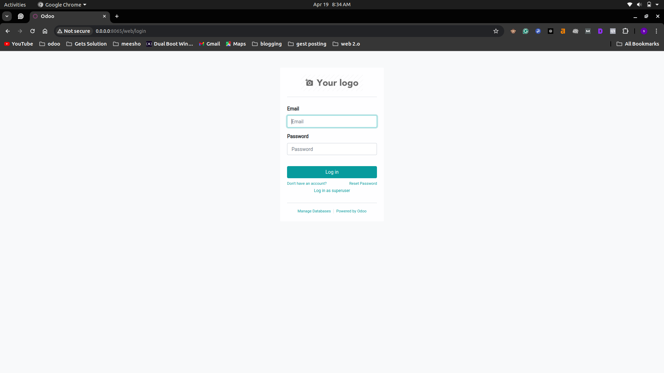
Login page

Slide 19
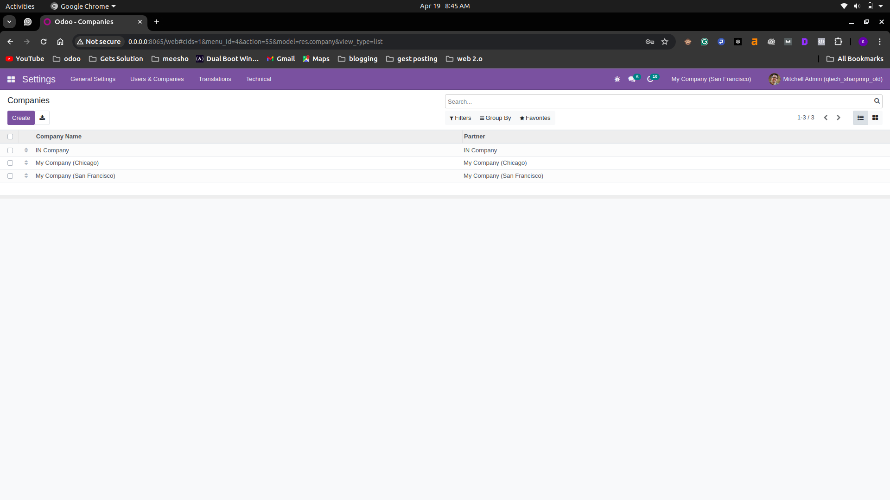
Company list view

Slide 20
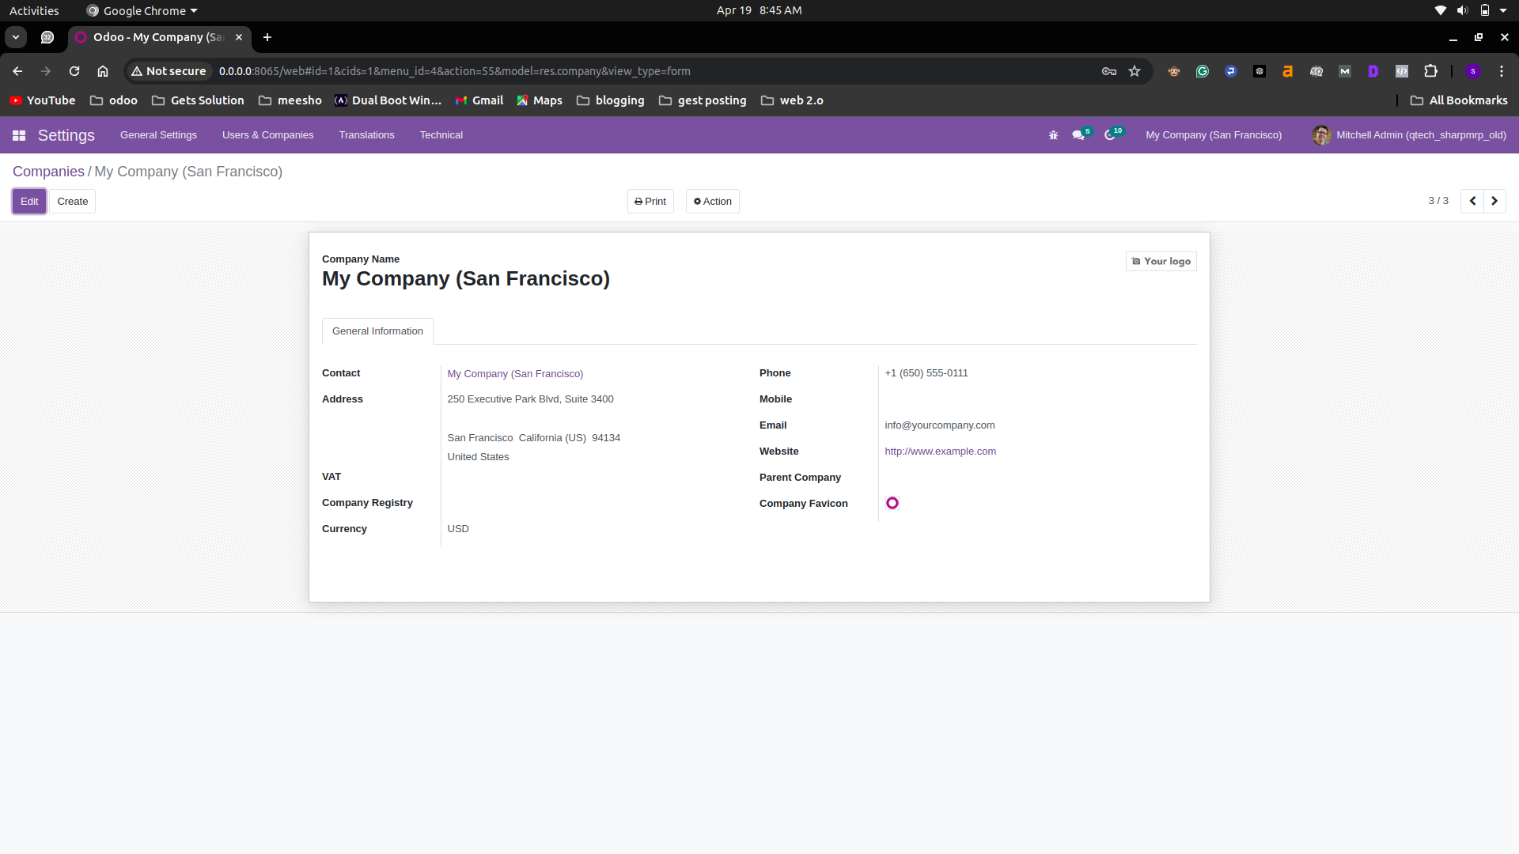
Company form view

Slide 21
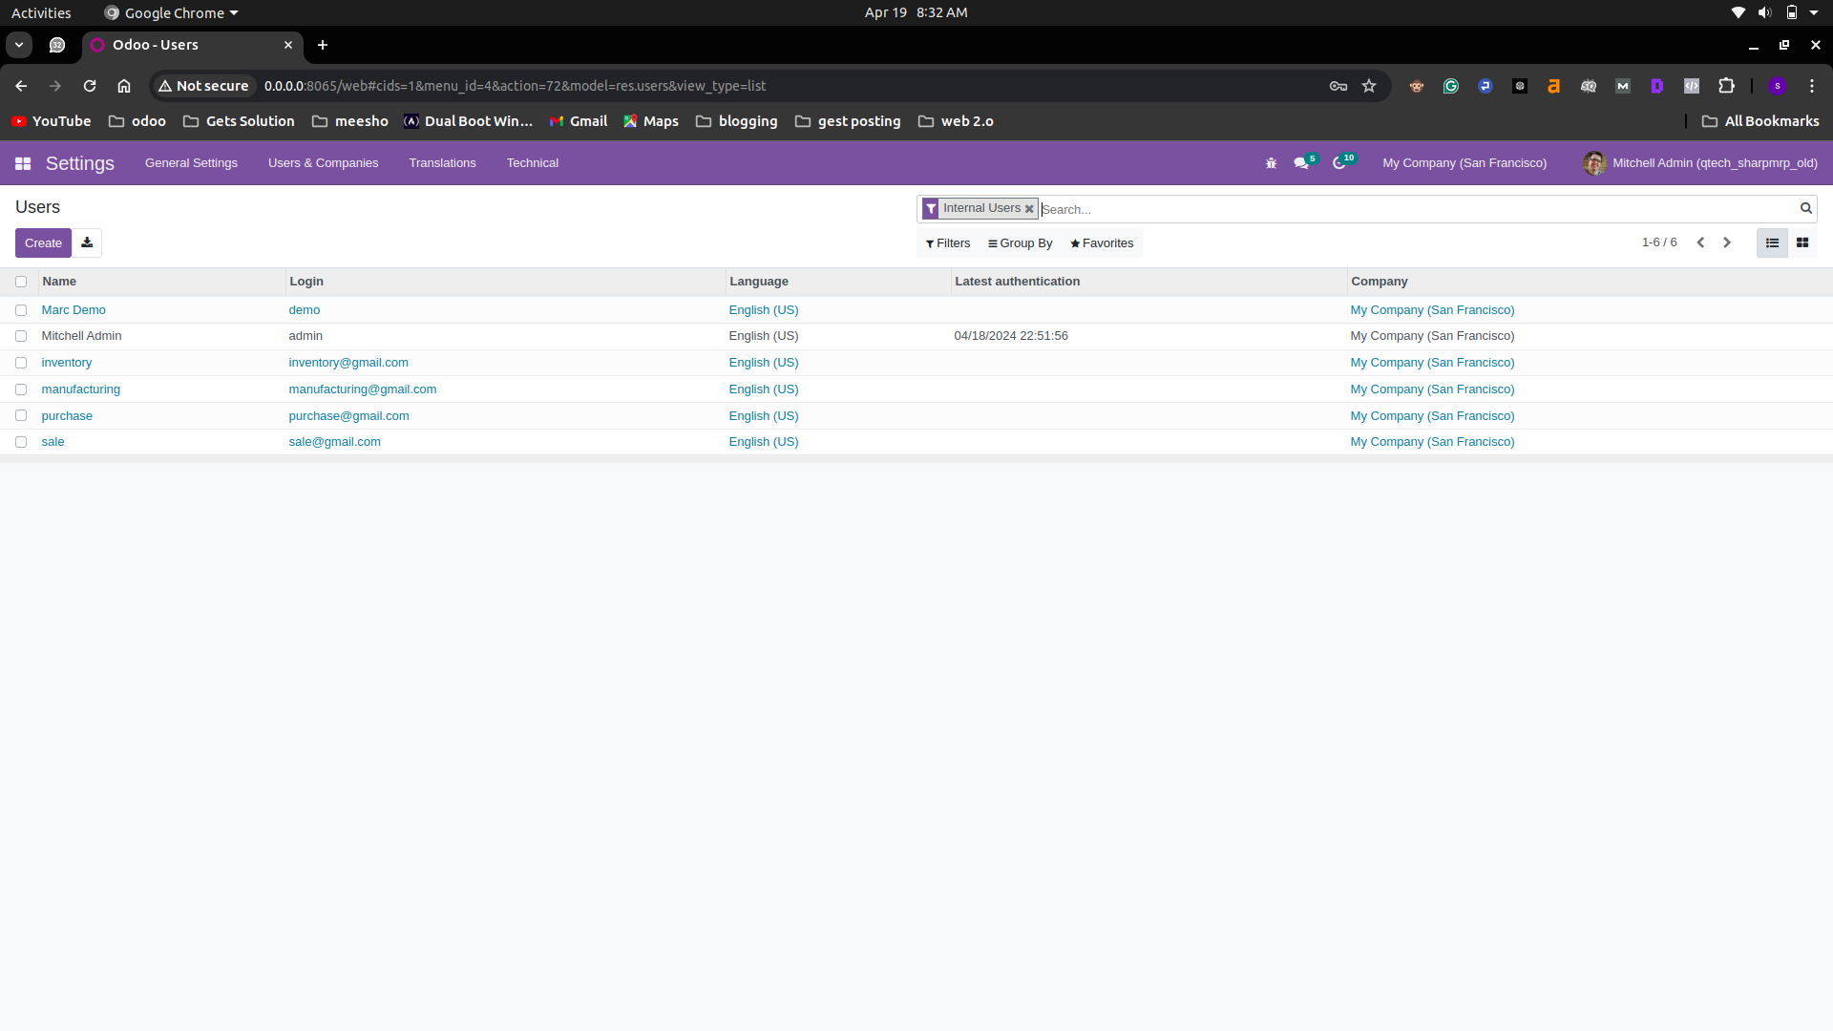
User list view

Slide 22
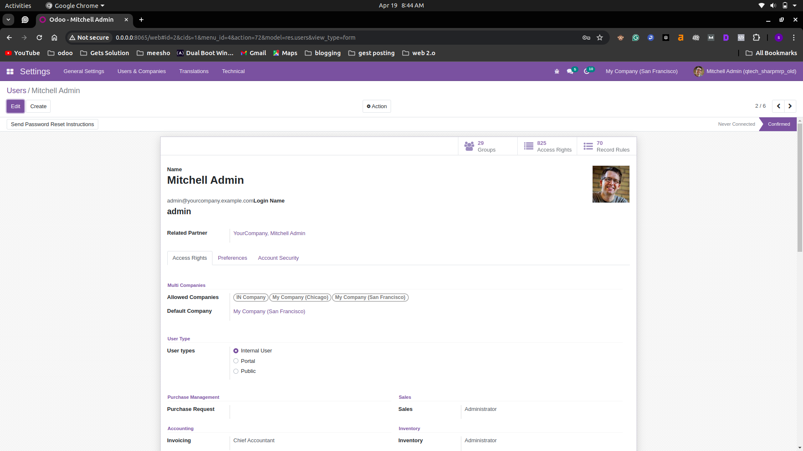
user from view

Slide 23
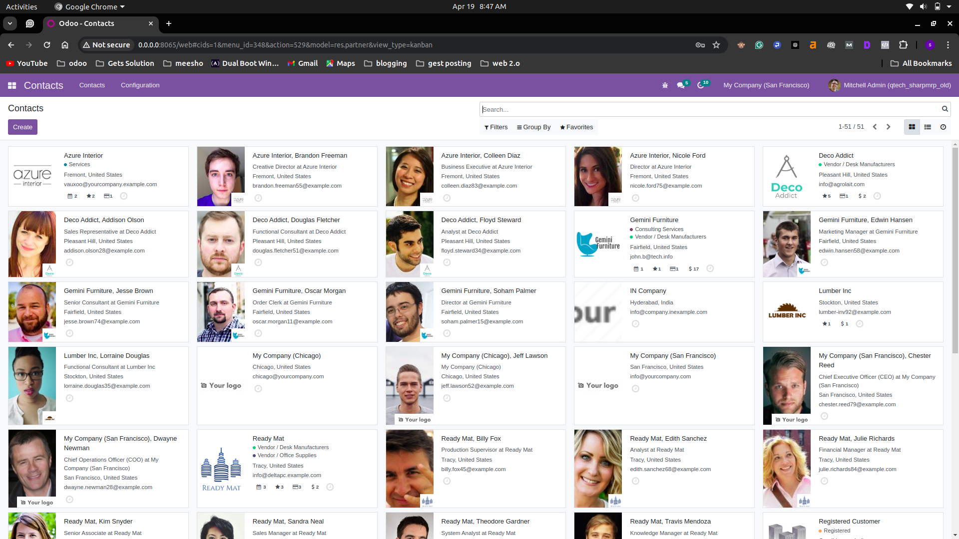
Contacts list view

Slide 24
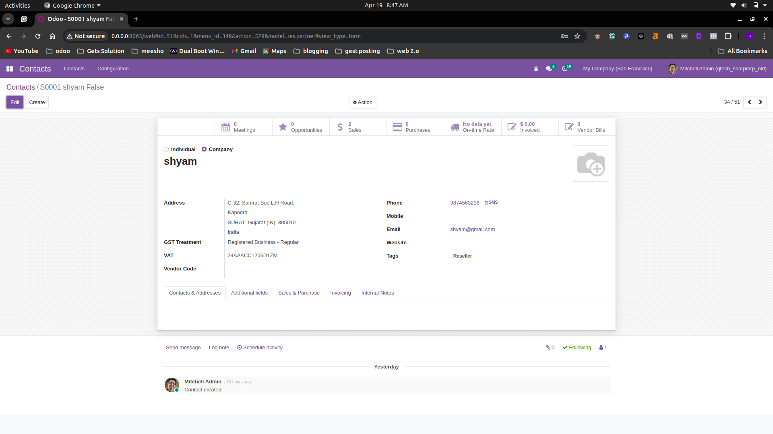
Contact form view

Slide 25
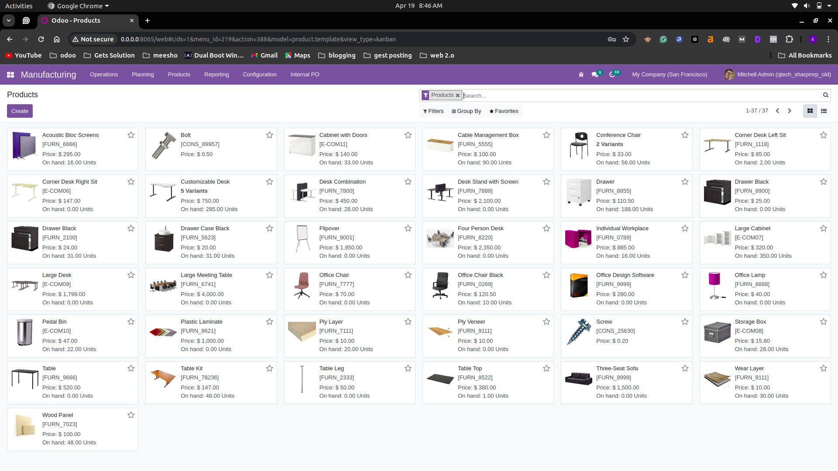
product list view

Slide 26
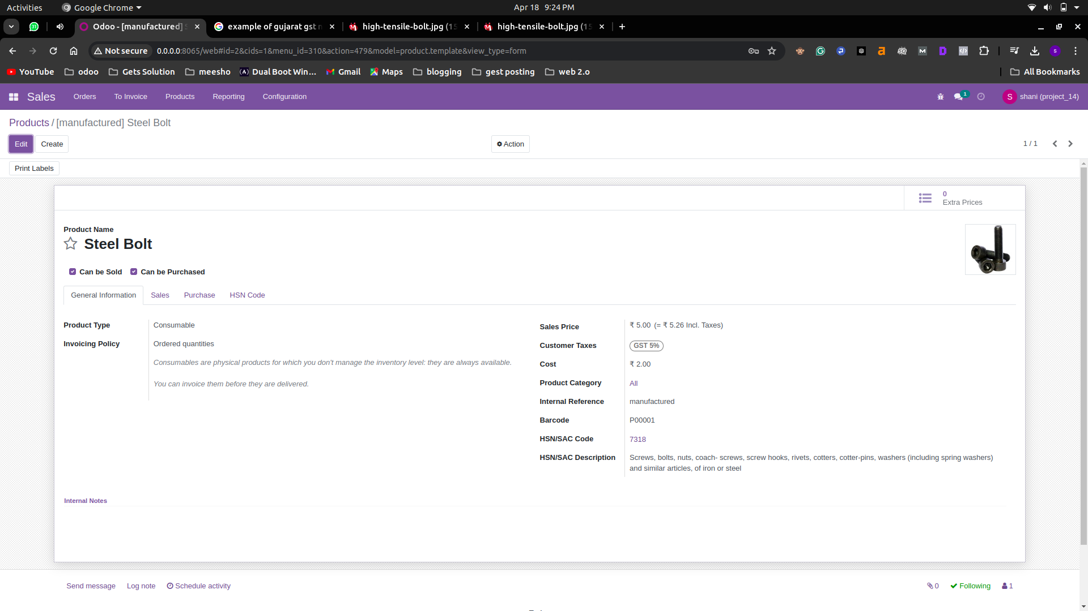
Product form view

Slide 27
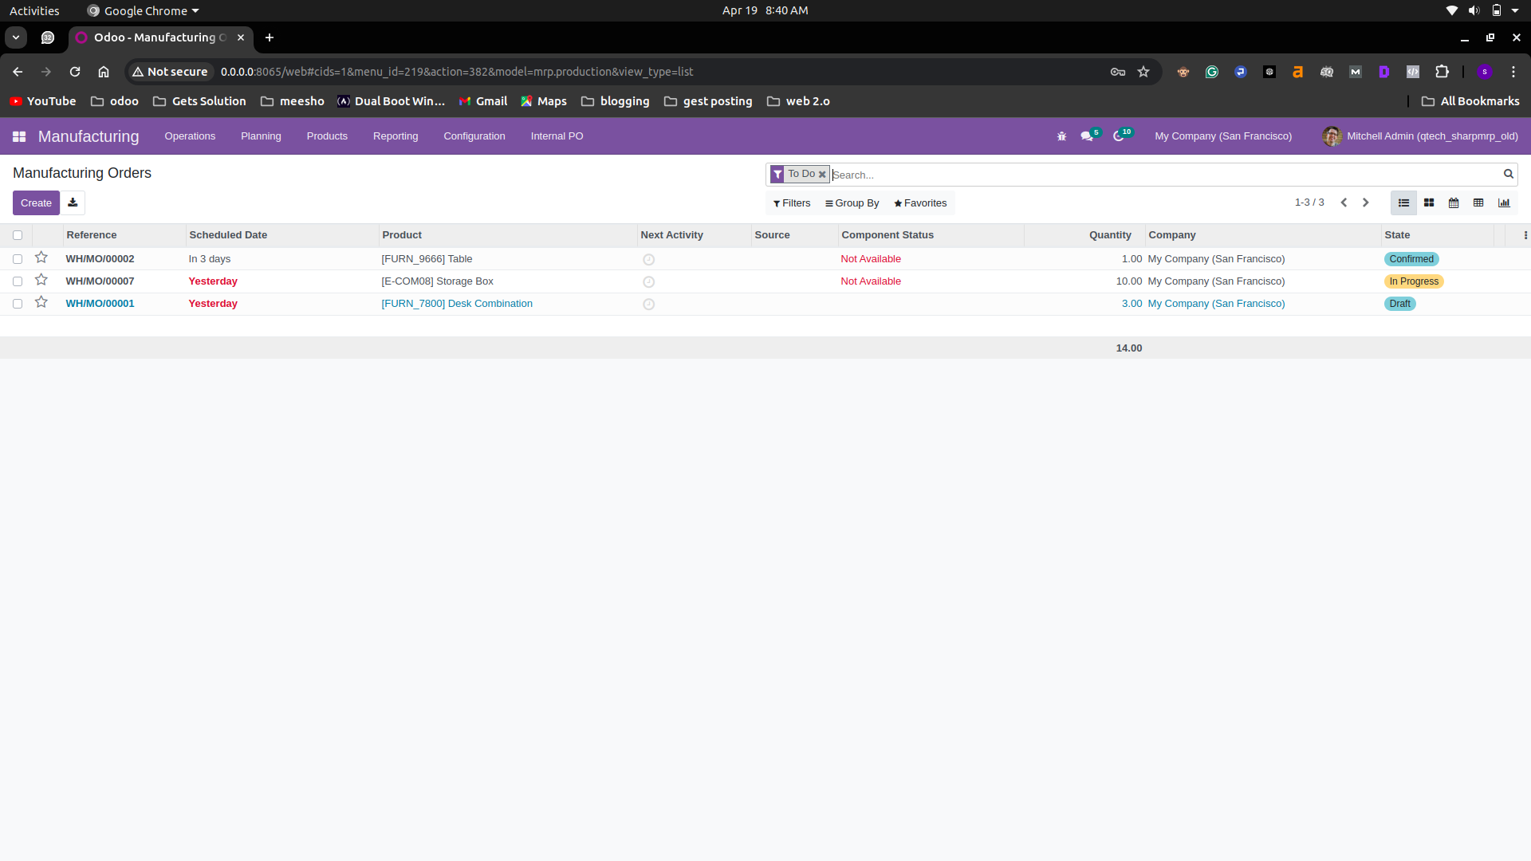
manufacturing list view

Slide 28
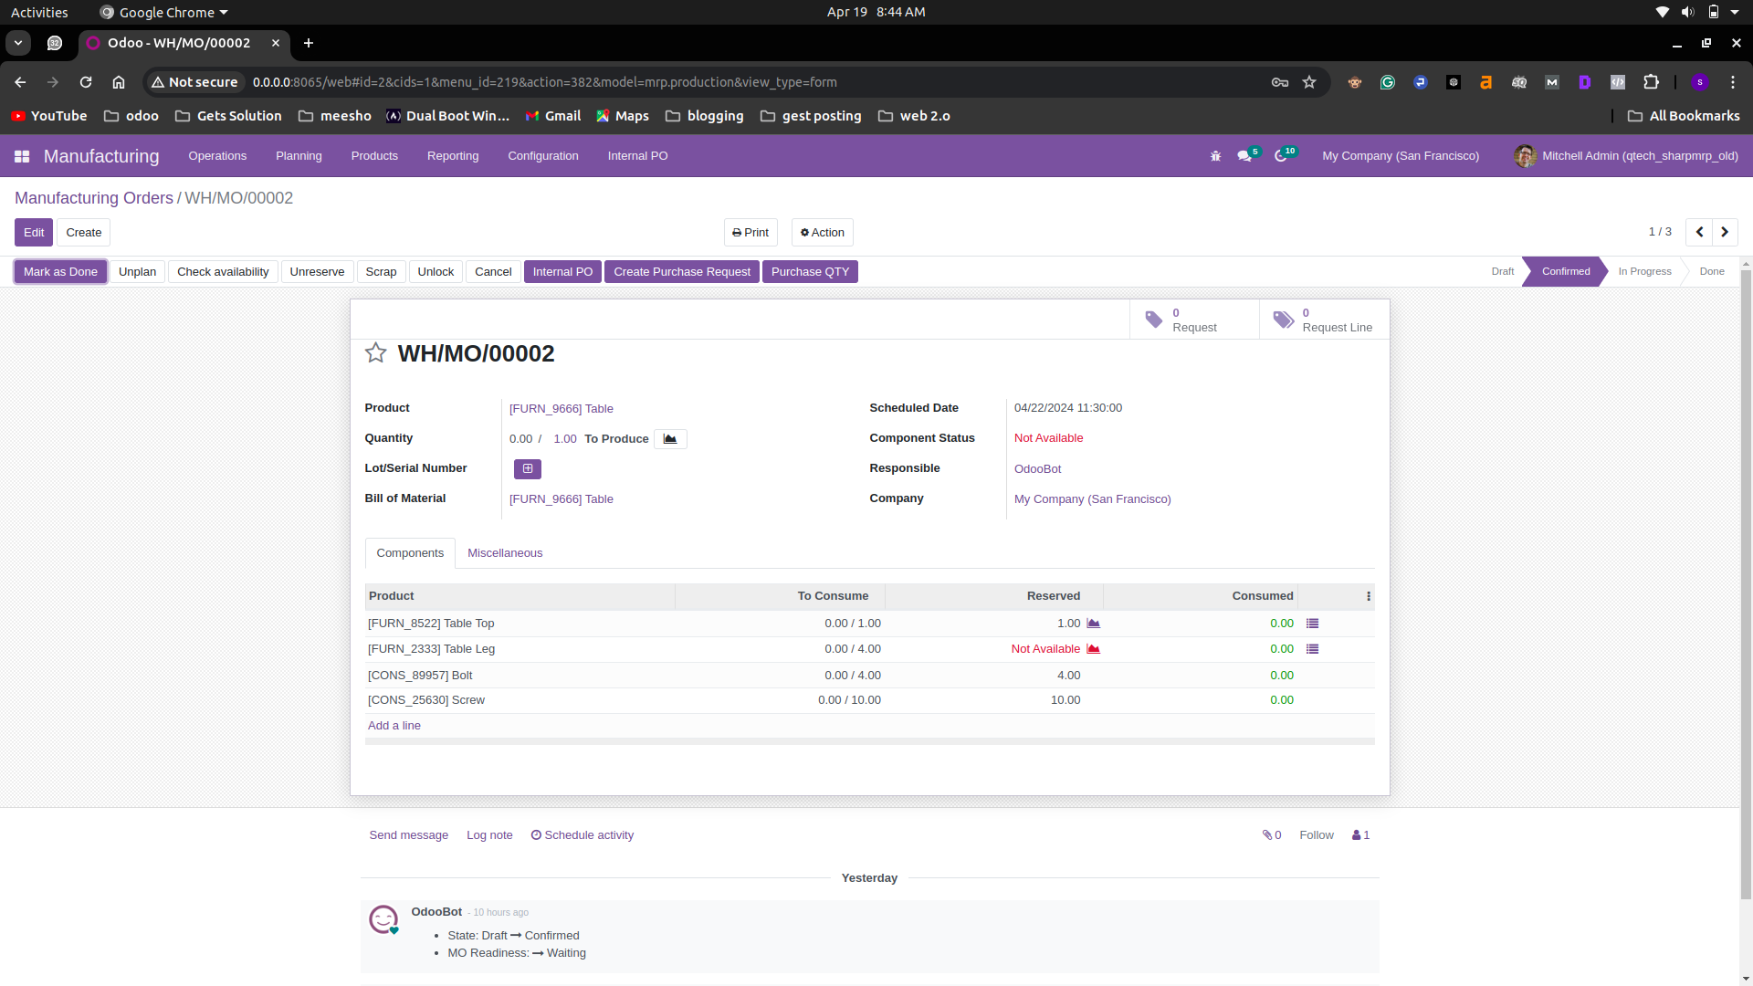
Manufacturing form view

Slide 29
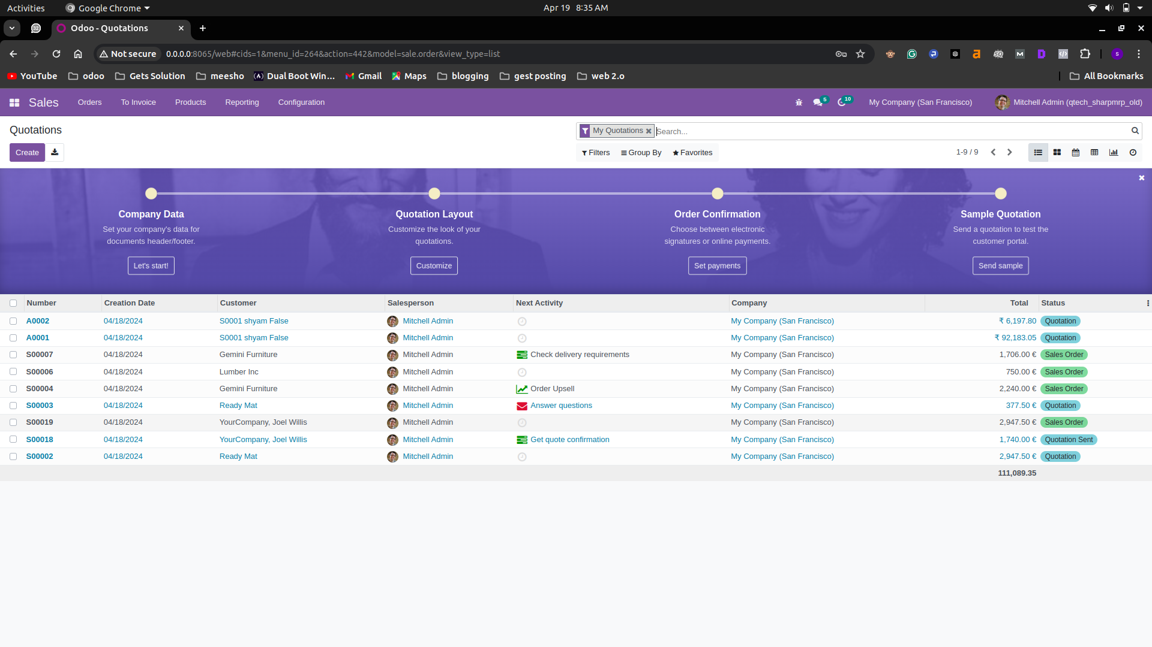
sales list view

Slide 30
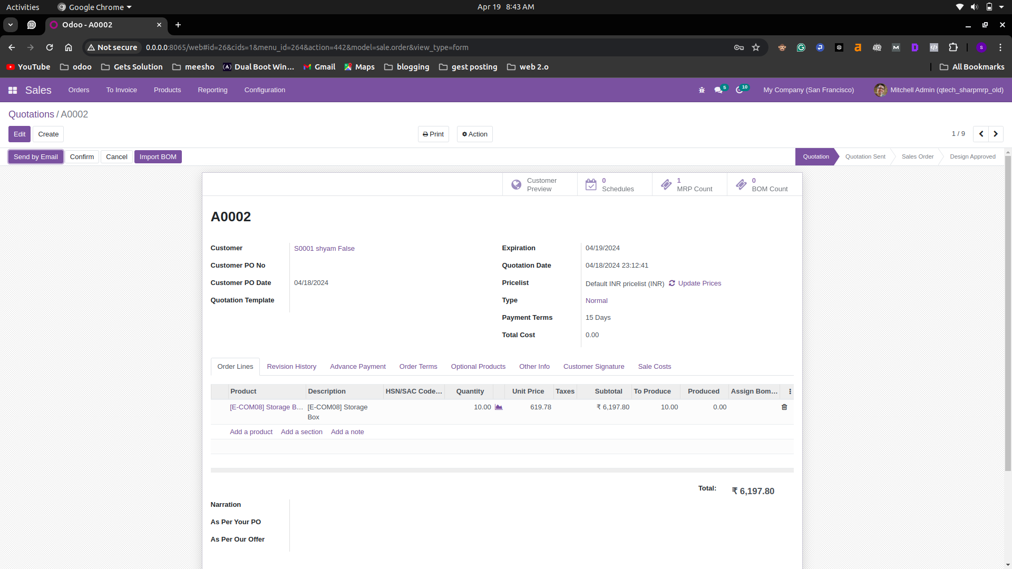
Sale form view

Slide 31
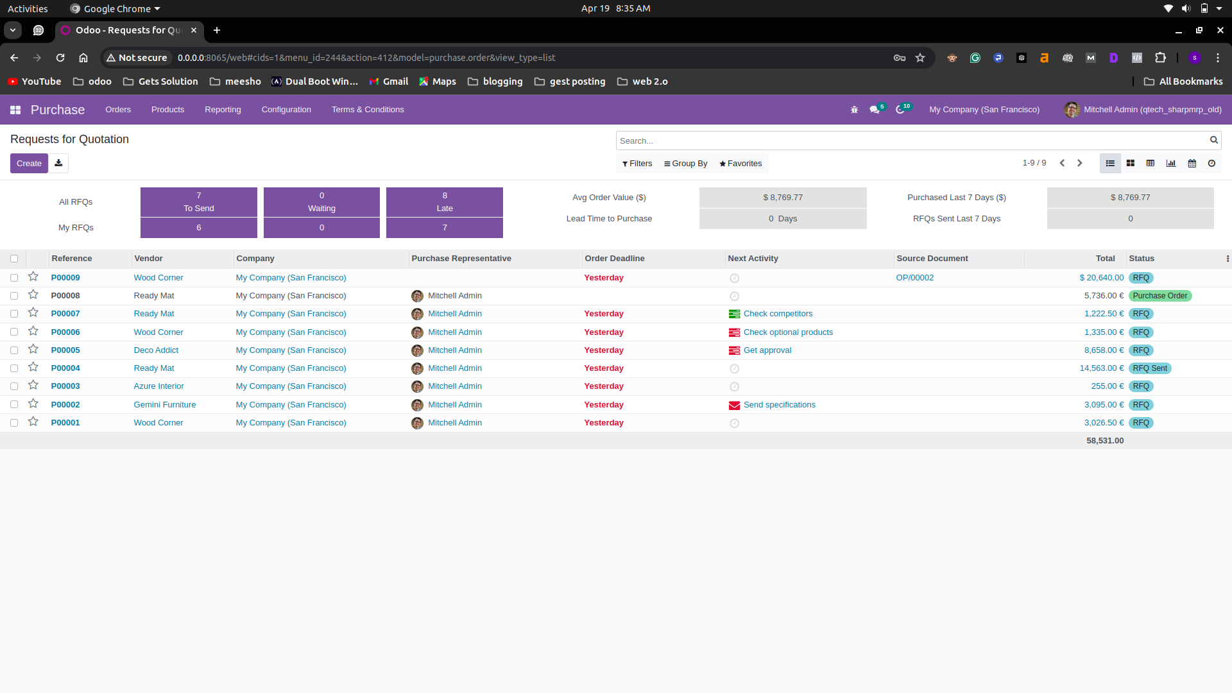
purchase list view

Slide 32
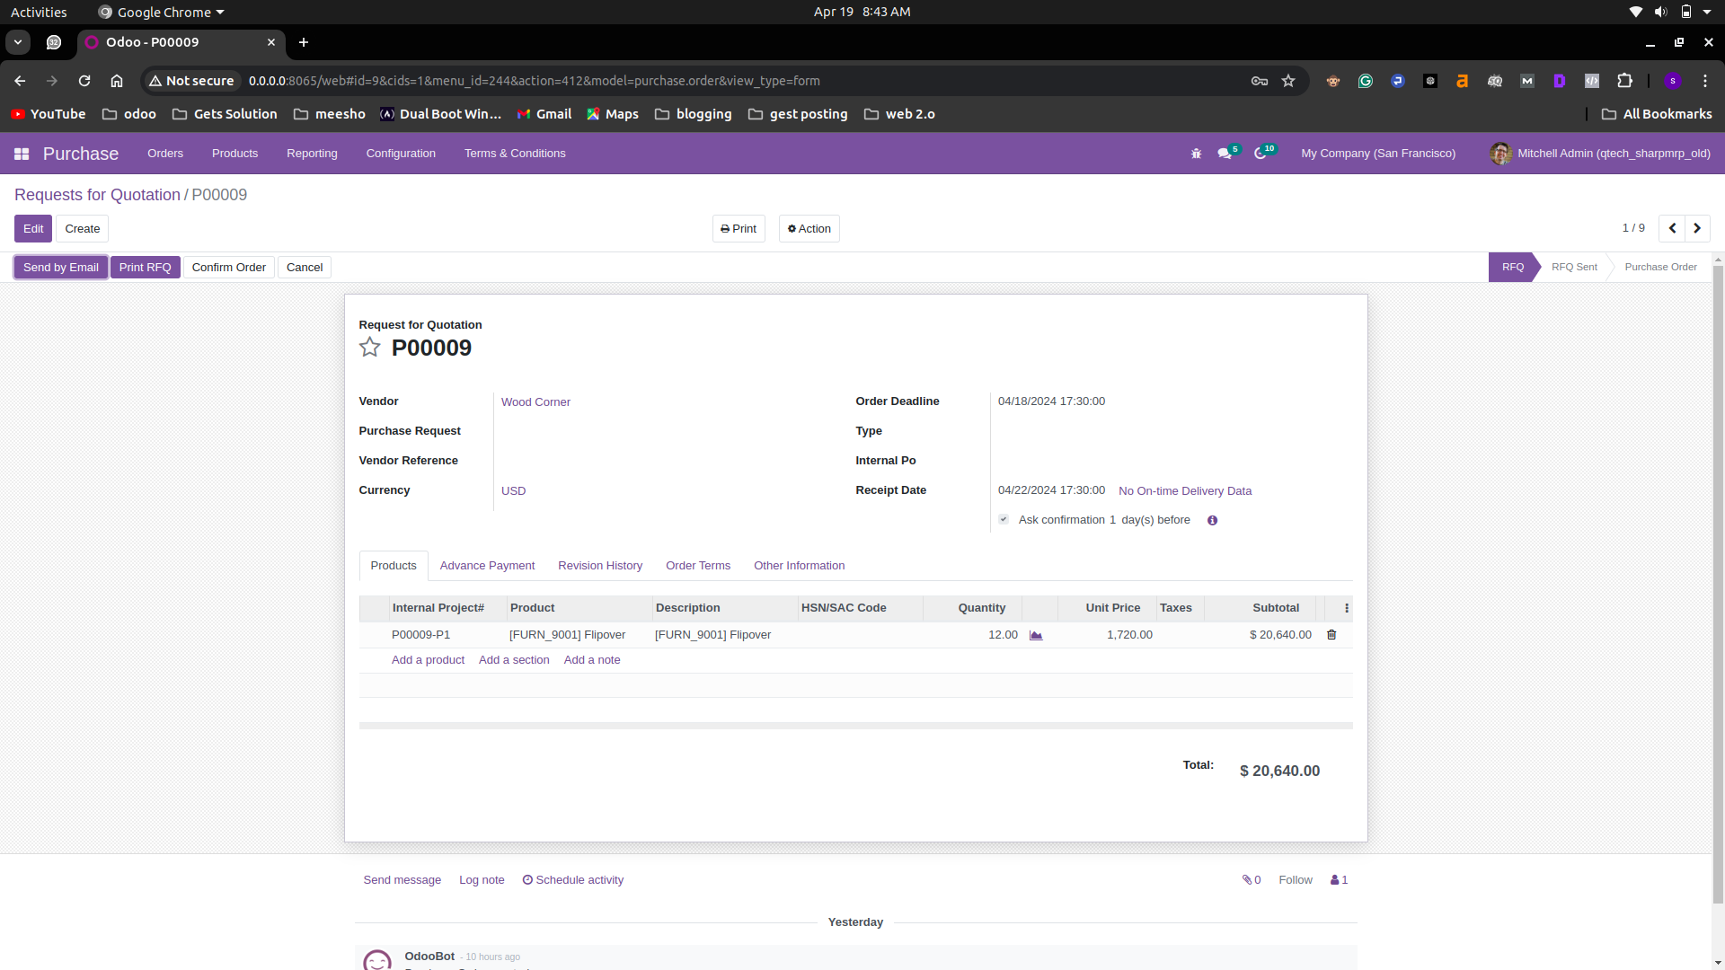
Purchase form view

Slide 33
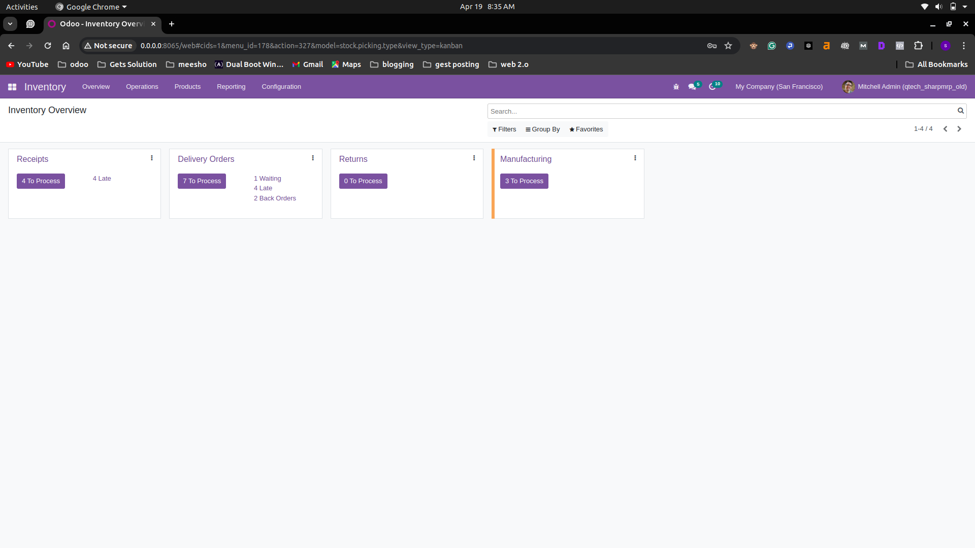
Inventory view

Slide 34
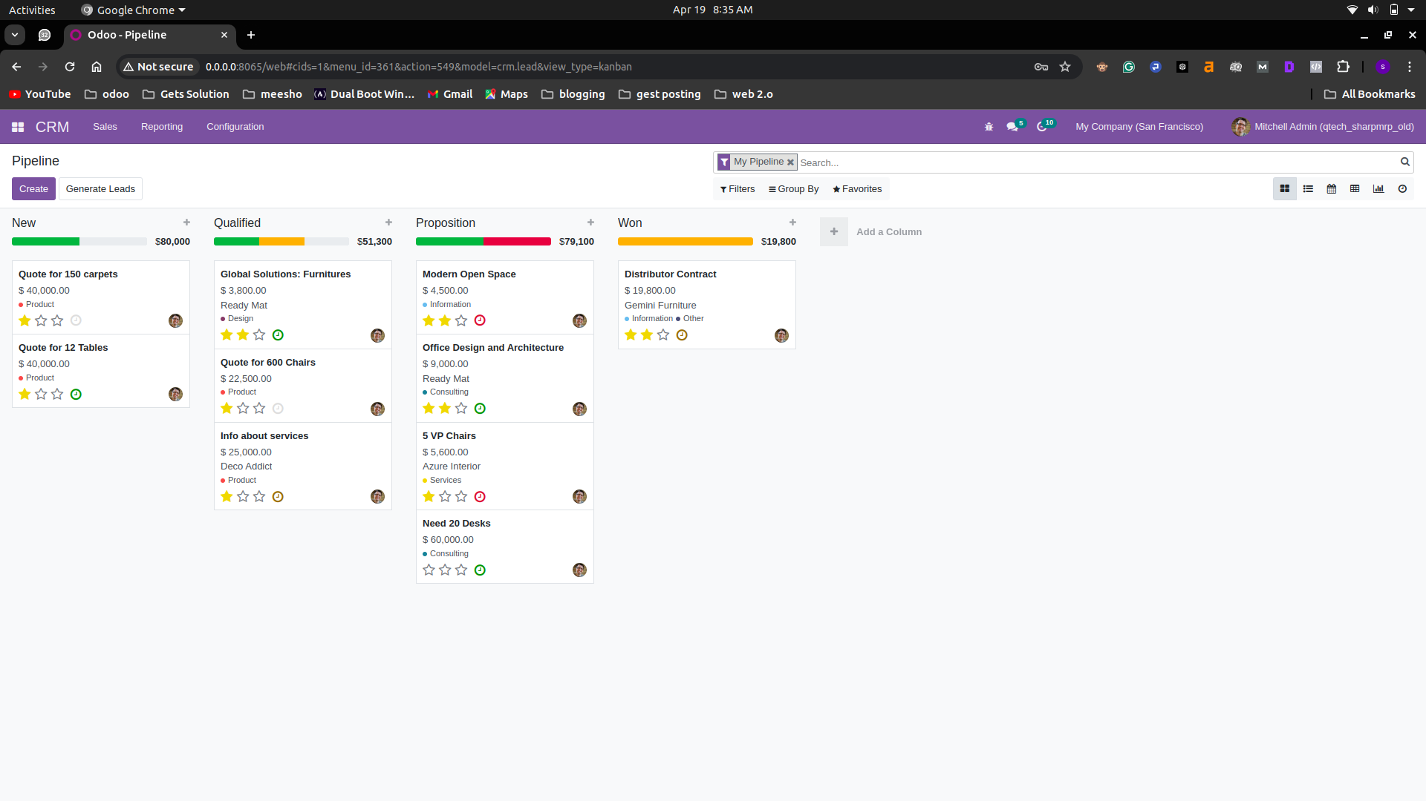
crm view

Slide 35
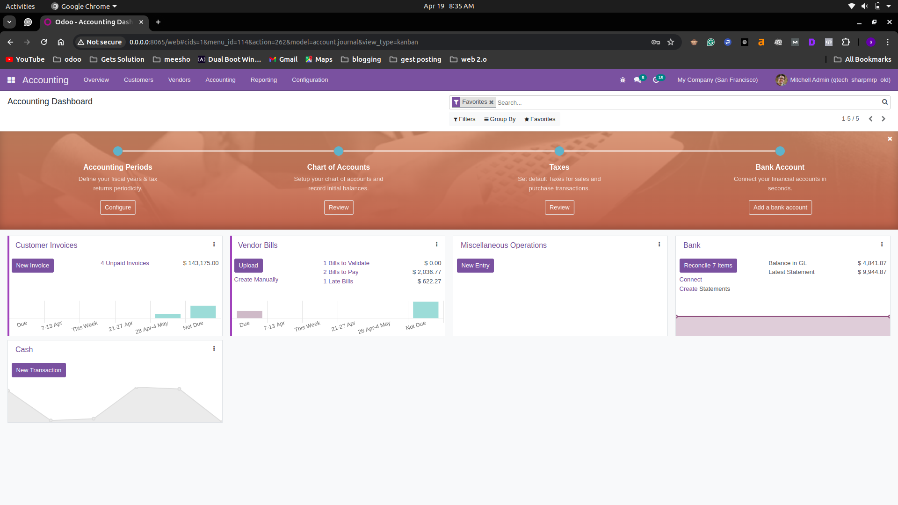
accounting view

Slide 36
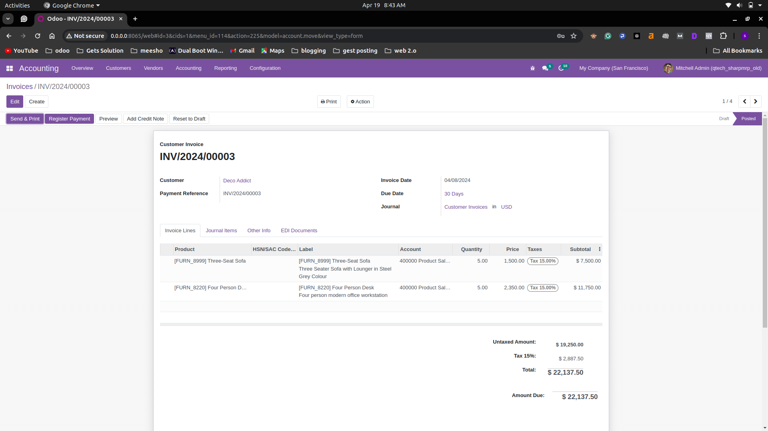
Accounting form view

Slide 37
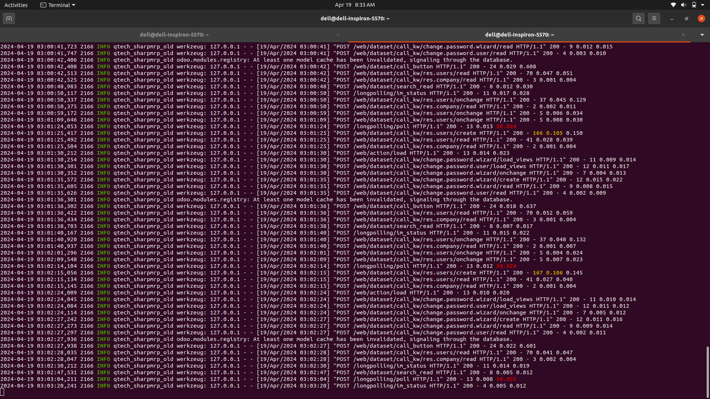
log view

Slide 38

Thank you
If you have any queries please tell us.

